Slide 1
Agentic AI Hackathon: Building Intelligent Agents with IBM Granite and LangFlow

Slide 2



Name of the team: Team Genai-ous
Details of Team members
TEAM MEMBER NAME | Recent Passport Photo | Email ID | Phone number [WhatsApp]
Neha Susan Baiju |  | nehasusan.cs23@bmsce.ac.in | 8310139352
Navneet Pitani |  | navneetpitani.cs23@bmsce.ac.in | 8618809134
C Krithi Reddy |  | ckrithi.cd23@bmsce.acib | 9019933055

Slide 3
Problem statement
Explainable Traffic Congestion Analysis
The Challenge
Urban travel is often frustrating, as commuters and planners face multiple challenges:
Information overload – traffic data comes from multiple sources such as GPS, sensors, cameras, and social media alerts, making it hard to get a clear picture.
Lack of transparency – standard traffic apps provide routes but rarely explain why congestion occurs or why a route is suggested.
Dynamic conditions – traffic congestion can change rapidly due to accidents, construction, weather, or special events, making real-time decision-making difficult.
Inefficient planning – without clear explanations of traffic patterns, commuters may choose suboptimal routes, leading to delays, higher fuel consumption, and increased stress.

Slide 4
Proposed solution
We are using Agentic AI system that:
Analyzes traffic data and identifies congestion areas.
Explains why congestion occurs and suggests optimal routes.
Adapts to real-time conditions like accidents or weather.
Provides commuters with clear, actionable insights and alternative routes.
This approach helps users make informed travel decisions, reduce delays, and improve urban mobility efficiency.
.

Slide 5
Need of project
Urban commuters and city planners face increasing challenges due to traffic congestion:
Time and productivity loss – inefficient route choices lead to longer travel times.
Lack of transparency – existing apps provide routes but rarely explain why traffic occurs.
Dynamic traffic conditions – accidents, weather, and construction cause unpredictable delays.
Environmental impact – congestion increases fuel consumption and emissions.
There is a clear need for an intelligent, explainable AI system that analyzes traffic, explains congestion causes, and suggests optimal routes, helping users make informed travel decisions and improving overall urban mobility.

Slide 6
End user of project
End Users of the Project
Daily commuters – people traveling to work, school, or personal errands who want faster and more predictable travel routes.
City planners and traffic authorities – to monitor congestion, understand causes, and plan traffic management strategies.
Logistics and delivery services – for optimizing delivery routes and minimizing delays.
Tourists and occasional travelers – to navigate unfamiliar cities efficiently with real-time guidance and route explanations.

Slide 7
Technology Used
1. Langflow Platform
Langflow Components:
  Chat Input
  Agent
  Chat Output
  File (Read File)
IBM Grainte model - for eg – ibm-granite-3-8b-instruct
IBM Cloud
IBM Watsonx.ai
Watsonx

Slide 8
Novelty and Uniqueness
·
Agentic Explainable AI: Unlike standard traffic apps that only give routes, this system uses multiple AI agents to analyze congestion, explain causes, and recommend routes with reasoning.
Grounded Knowledge with File Component: By referencing a traffic knowledge file, the system produces accurate, context-aware explanations, reducing reliance on LLM memory alone.
Modular Multi-Agent Architecture: Each agent has a clear responsibility (analysis, reasoning, route planning), making the system transparent, scalable, and easy to maintain.
Real-Time Adaptability: Can incorporate dynamic traffic conditions like accidents, weather, and construction into decision-making.
User-Centric Output: Presents congestion areas, causes, and alternative routes in a readable, actionable format, enhancing user trust and decision-making.
Model-Agnostic Design: Although using IBM Granite here, the system can switch LLMs easily (OpenAI, Ollama, Groq), making it flexible and future-proof.·
·

Slide 9
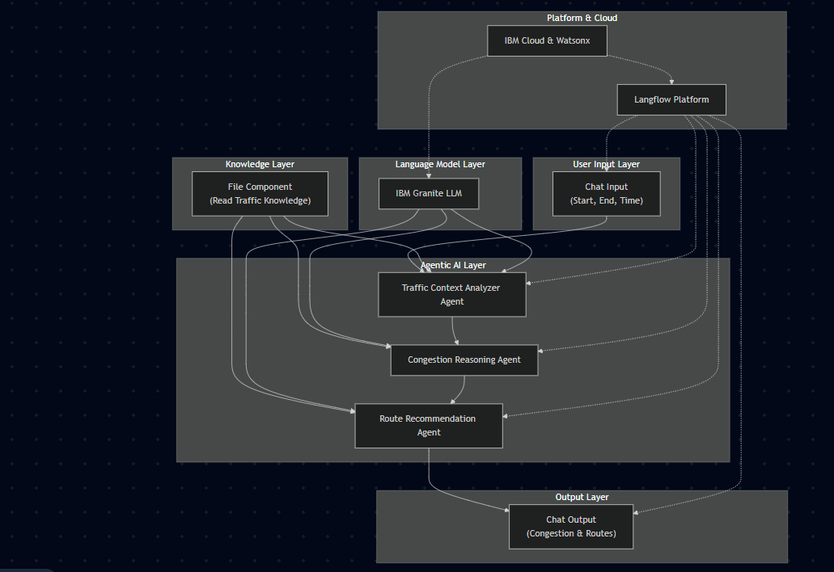
Technical flow diagram - Architecture blueprint

Slide 10
Langflow component Used
1) Chat Input
Used to collect user trip details such as starting location, ending location, and departure time.
It serves as the entry point of the system and passes user input to the AI agents.
2) IBM watsonx AI Agent
Used for intelligent traffic analysis and explainable reasoning.
Different agents analyze congestion, explain causes, and recommend alternate routes based on traffic patterns.
3) File Component
Used to store supporting traffic knowledge such as common congestion causes and road behavior patterns.
It helps ground the agent responses and improves explanation quality.
4) Language Model Component
Provides the foundation model that powers all AI agents.
It enables reasoning, explanation, and natural language output.
5) Chat Output
Displays the final congestion analysis, explanations, and route recommendations to the user in a clear and structured format

Slide 11
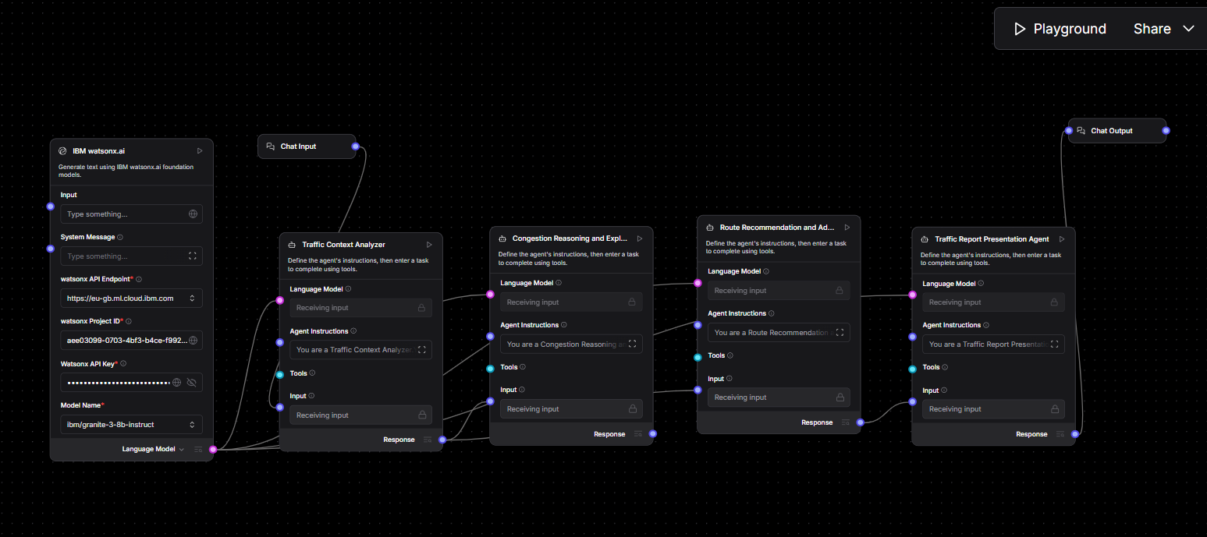
Input Screenshot 1

Slide 12
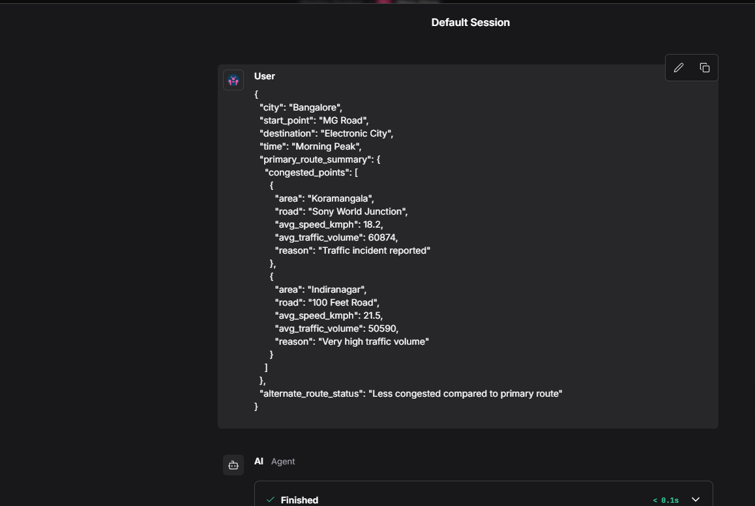
Input Screenshot 2

Slide 13
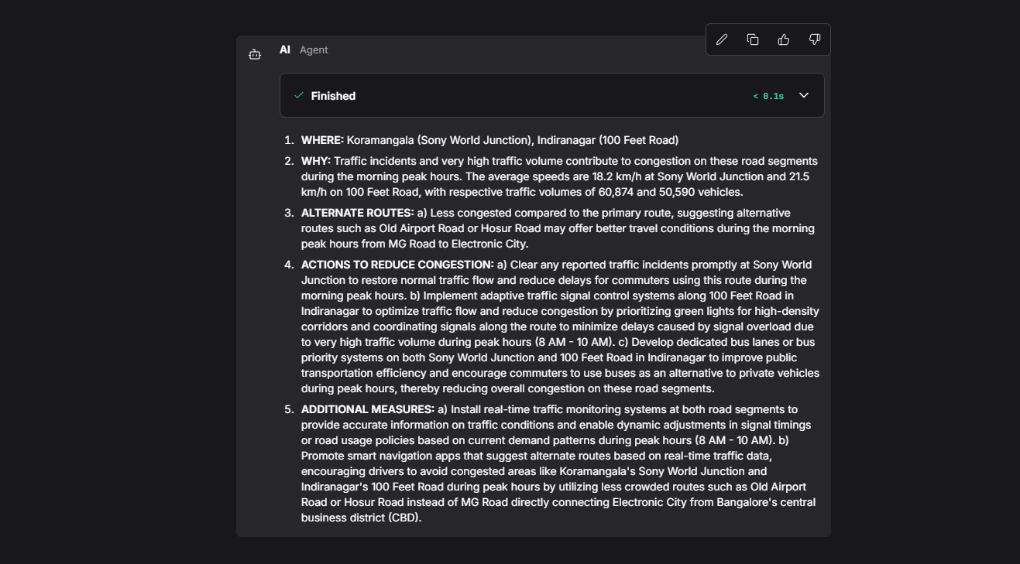
Input Screenshot 2

Slide 14
Future Scope
Integrate real-time traffic data for dynamic updates.
Use RAG for verified congestion information.
Add predictive traffic analysis for proactive route suggestions.
Expand to mobile apps and multi-city transport modes.
Personalize routes based on user preferences and eco-friendly metrics.
·
·
·

Slide 15
Git Hub Link
Github URL –https://github.com/NehaSusan14/IBM-PROJECT
·
·
·

Slide 16
References
· https://docs.langflow.org/
https://www.ibm.com/think/topics/agentic-ai
https://dataoids.com/blogs/agentic-ai-air-traffic-management/
·
·
·

Slide 17


